Slide 1
Validation of Measurement
Measurement on Merlin board
overlapping memory request:
Measured on Merlin board: D’=M1=M2=M3
Collect memory trace at D’
Input memory trace to simulator’s host
Expect: M5 (= E’) = C = E (from HMC simulator)
Simulation on HMC Simulator

Slide 2
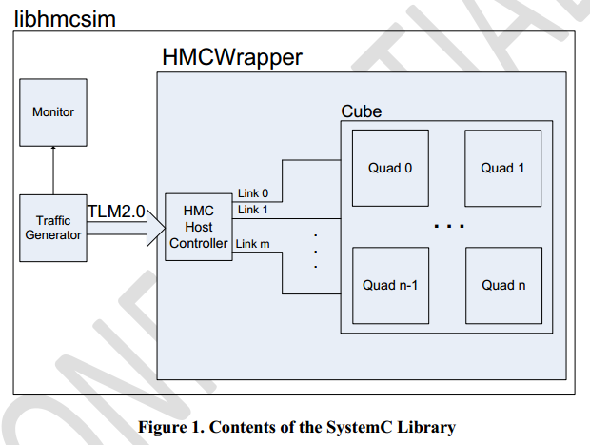
HMC SytemC Simulator - Architecture
Cycle-accurate simulator
by Micron
Main modules:
Synthetic traffic generator
Host controller
HMCWrapper
Monitor
Host Controller
Map requests to links
Create formatted packets (places
in corresponding request buffer)
Micron Technology, Inc., HMC SystemC Model
Document Revision 1.0 (SVN R194)

Slide 3
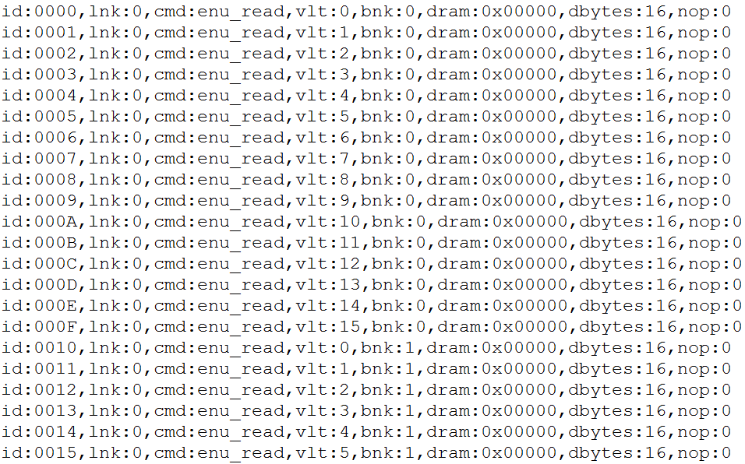
Generated Trace File – For Simulator

Slide 4
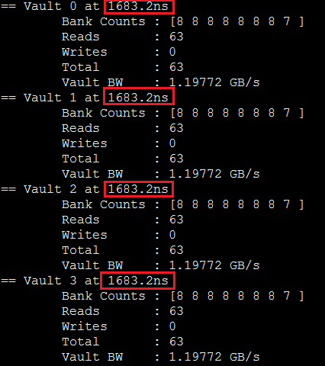
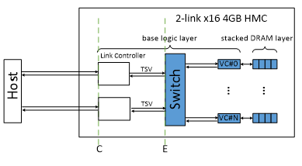
Simulator Results – Overlapping memory read requests
The bandwidth and latency calculations are measured on the pins of the HMC (M5 point on the merlin board)

Slide 5
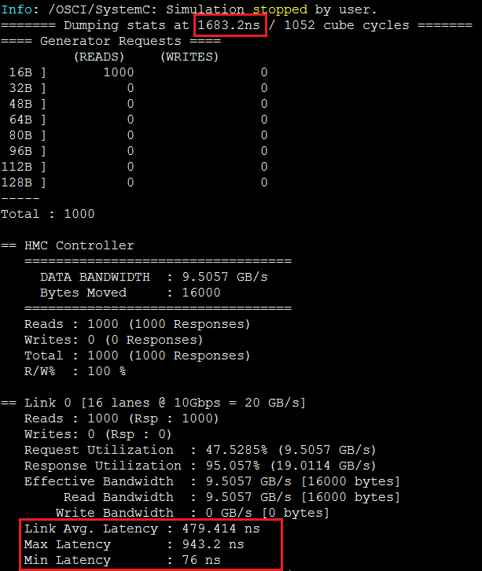
Simulator Results – Overlapping memory read requests
The bandwidth and latency calculations are measured on the pins of the HMC (M5 point on the merlin board)

